Slide 1
Multimedia
Lossless Compression

Slide 2
Variable length coding
<number>

Slide 3
Example 1
Suppose we have the following string: 5,5,5,5,8,8,4,2,7,7,7,2,2,2,2,4,4,7,7,7,7,2,2,2,2,2,2,2,2,2,2,2,2,2,2,2,2,4,4,4
symbol | freq | prob | code | 1 | code | 2 | code | 3 | code
2 | 21 | 0.53 | 0 | 0.53 | 0 | 0.53 | 0 | 0.53 | 0
7 | 7 | 0.18 | 11 | 0.18 | 11 | 0.3 | 10 | 0.48 | 1
4 | 6 | 0.15 | 100 | 0.15 | 100 | 0.18 | 11
5 | 4 | 0.1 | 1010 | 0.15 | 101
8 | 2 | 0.05 | 1011
 | 40 | 1
<number>

Slide 4
Solution
symbol | freq | prob | code | 1 | code | 2 | code | 3 | code
2 | 21 | 0.53 | 0 | 0.53 | 0 | 0.53 | 0 | 0.53 | 0
7 | 7 | 0.18 | 11 | 0.18 | 11 | 0.3 | 10 | 0.48 | 1
4 | 6 | 0.15 | 100 | 0.15 | 100 | 0.18 | 11
5 | 4 | 0.1 | 1010 | 0.15 | 101
8 | 2 | 0.05 | 1011
 | 40 | 1
<number>

Slide 5
Average code length
The average codeword length for this code is : l = 0.53 x 1 + 0.18 x 2 + 0.15 x 3 + 0.1 x 4 + 0.05 x 4 = 1.94 bits/symbol.
<number>

Slide 6
Example 2
Let A = {a₁, …, a₅}, P(a_{i}) = {0.2, 0.4, 0.2, 0.1, 0.1}.
symbol | prob | code | 1 | code | 2 | code | 3 | code
a₂ | 0.4 |  | 0.4 |  | 0.4 |  | 0.6
a₁ | 0.2 |  | 0.2 |  | 0.4 |  | 0.4
a₃ | 0.2 |  | 0.2 |  | 0.2
a₄ | 0.1 |  | 0.2
a₅ | 0.1
 | 1
<number>

Slide 7
Solution
symbol | prob | code | 1 | code | 2 | code | 3 | code
a₂ | 0.4 | 1 | 0.4 | 1 | 0.4 | 1 | 0.6 | 0
a₁ | 0.2 | 01 | 0.2 | 01 | 0.4 | 00 | 0.4 | 1
a₃ | 0.2 | 000 | 0.2 | 000 | 0.2 | 01
a₄ | 0.1 | 0010 | 0.2 | 001
a₅ | 0.1 | 0011
 | 1
<number>

Slide 8
Average code length
The average codeword length for this code is : l = 0.4 x 1 + 0.2 x 2 + 0.2 x 3 + 0.1 x 4 + 0.1 x 4 = 2.2 bits/symbol.
<number>

Slide 9
Dictionary based coding
<number>

Slide 10
LZW algorithm
The Lempel-Ziv-Welch (LZW) algorithm employs an adaptive, dictionary-based compression technique. Unlike variable-length coding, in which the lengths of the codewords are different, LZW uses fixed-length codewords to represent variable length strings of symbols/characters that commonly occur together, such as words in English text.
<number>

Slide 11
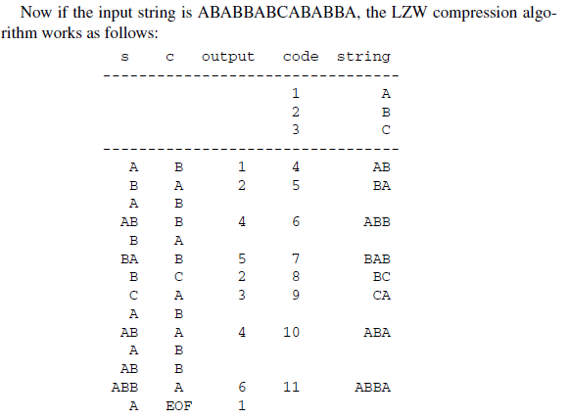
LZW Compression algorithm
BEGIN
s = next input character;
while not EOF
{
c = next input character;
if s + c exists in the dictionary
s = s + c;
else
{
output the code for s;
add string s + c to the dictionary with
a new code;
s = c;
}
}
output the code for s;
END
<number>

Slide 12

Example
Compression for String ABABBABCABABBA
Let us start with a very simple dictionary (also referred to as a string table), initially containing only three characters, with codes as follows:
<number>

Slide 13
The output codes are 1 2 4 5 2 3 4 6 1. Instead of 14 characters, only 9 codes need to be sent. If we assume each character or code is transmitted as a byte, that is quite a saving (the compression ratio would be 14/9 = 1.56).
<number>

Slide 14
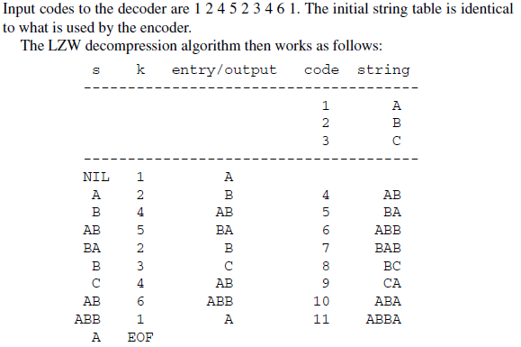
LZW Decompression algorithm
BEGIN
s = NIL;
while not EOF
{
k = next input code;
entry = dictionary entry for k;
output entry;
if (s != NIL)
add string s + entry[0] to dictionary
with a new code;
s = entry;
}
END
<number>

Slide 15
<number>

Slide 16
Questions?
<number>

